Slide 1
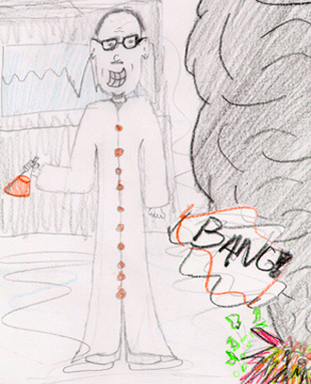

Slide 2
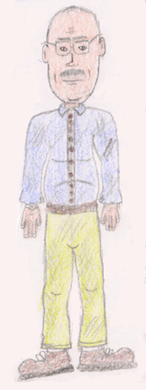
Before After

Slide 3
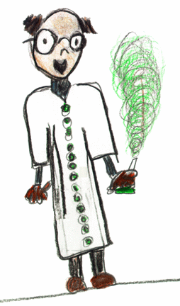
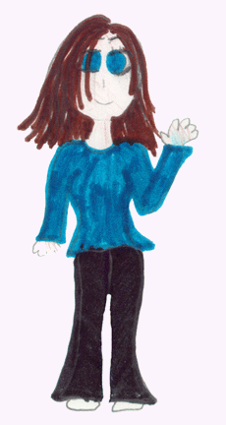
Before After

Slide 4
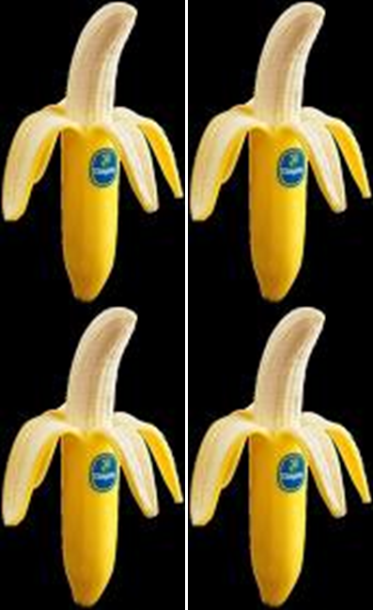
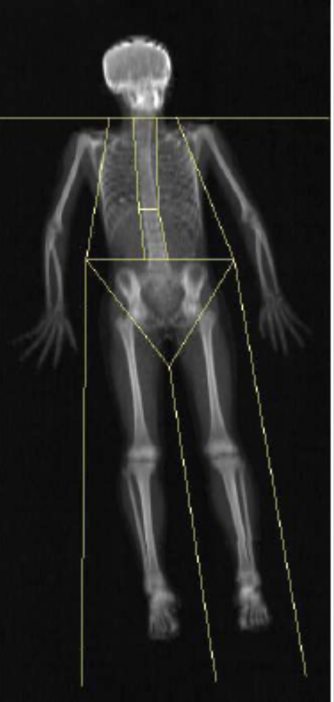
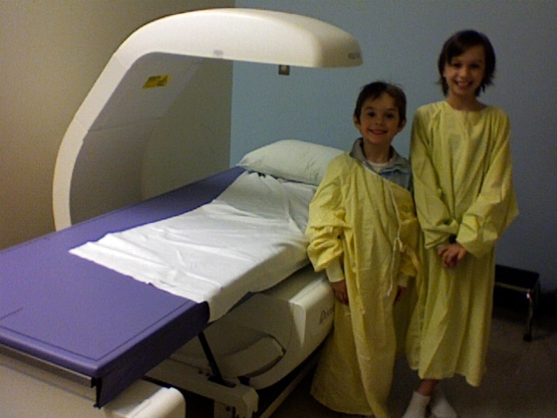
Osteoporosis Dual X-Ray Absorption February 6, 2008

Slide 5

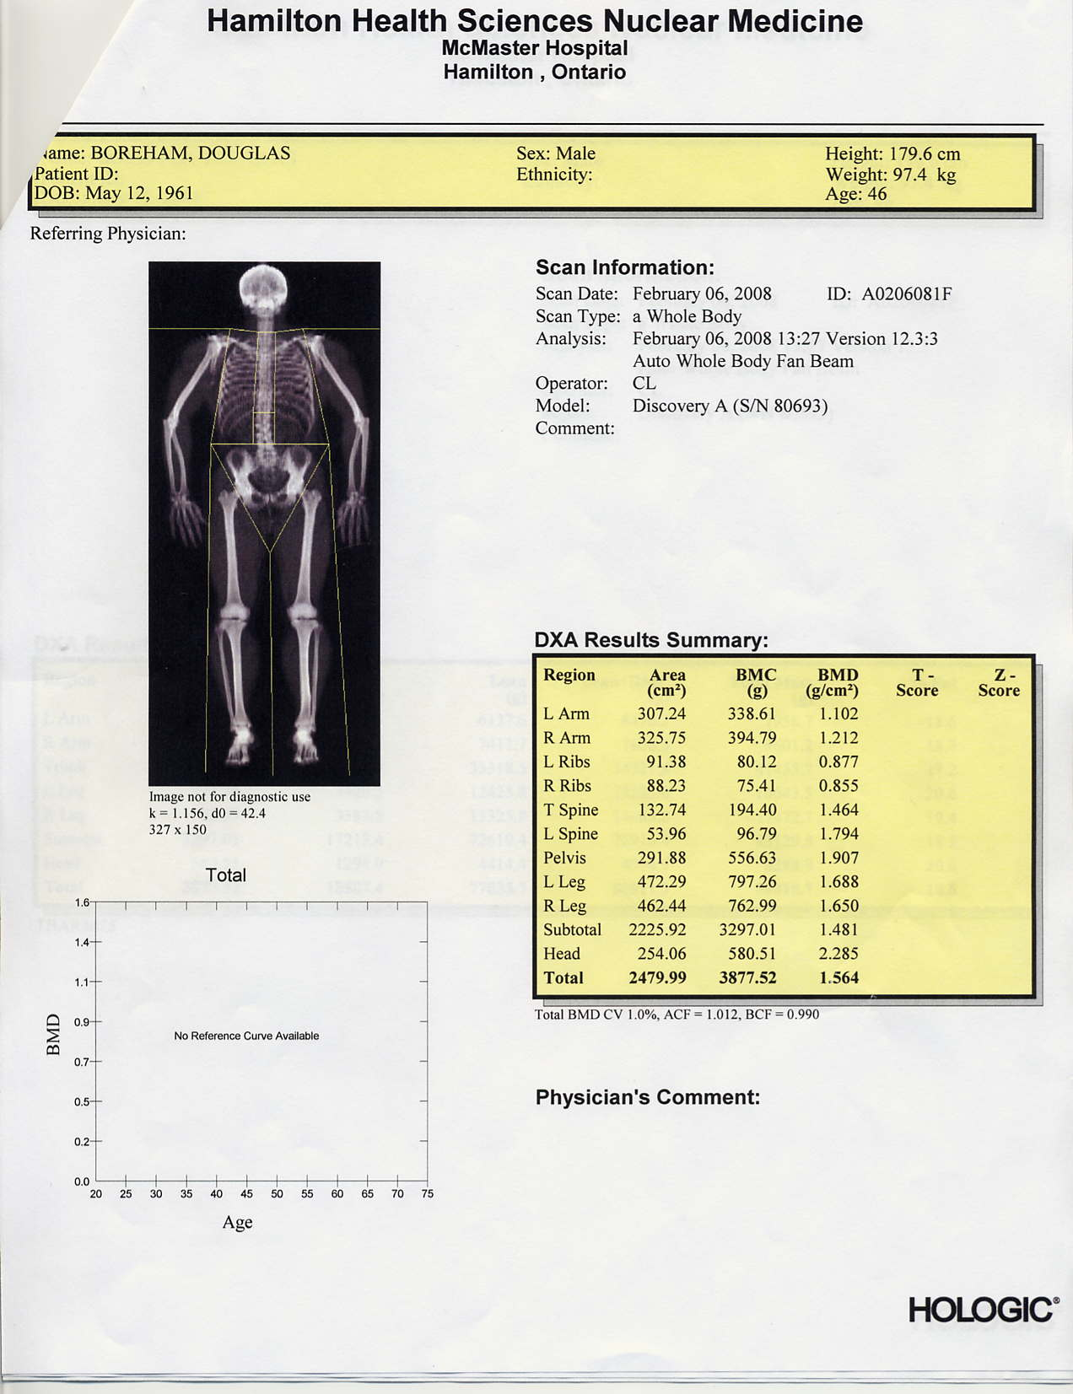
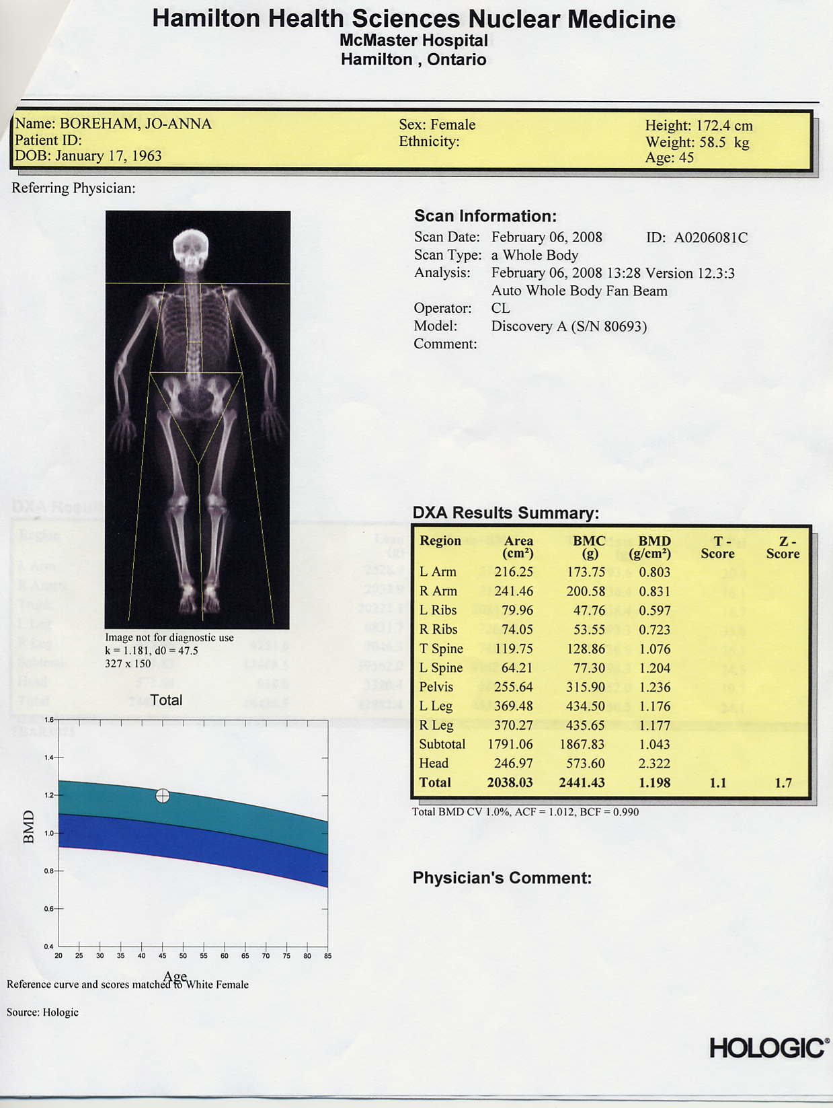


Merry Christmas 2011
From the Boreham and Dolling’s
Doug Jo-Anna Roberta Harry

Slide 6
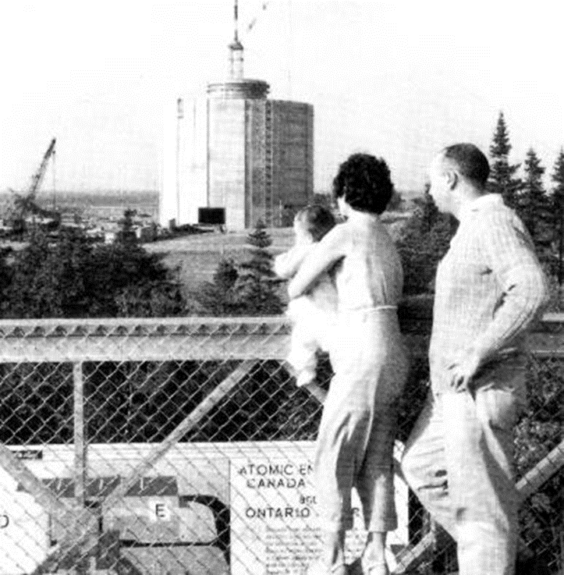

Slide 7
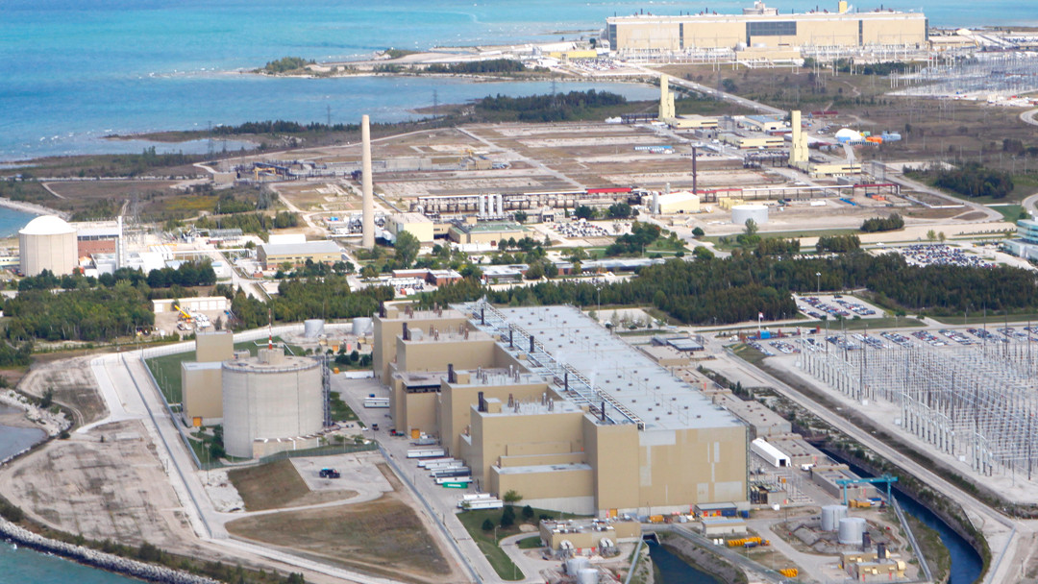
Bruce Power Signs Deal with Ontario
December 3, 2015
Sustaining 8 Units Until 2065 (6300 MW Output)
Six Refurbishments (2020) $8 billion.
Long-term (2016-2065) Life Extension Activities $5 billion.
Short-term 2016 and 2020 $2.3 billion.
Total Investment $15.3 Billion

Slide 8
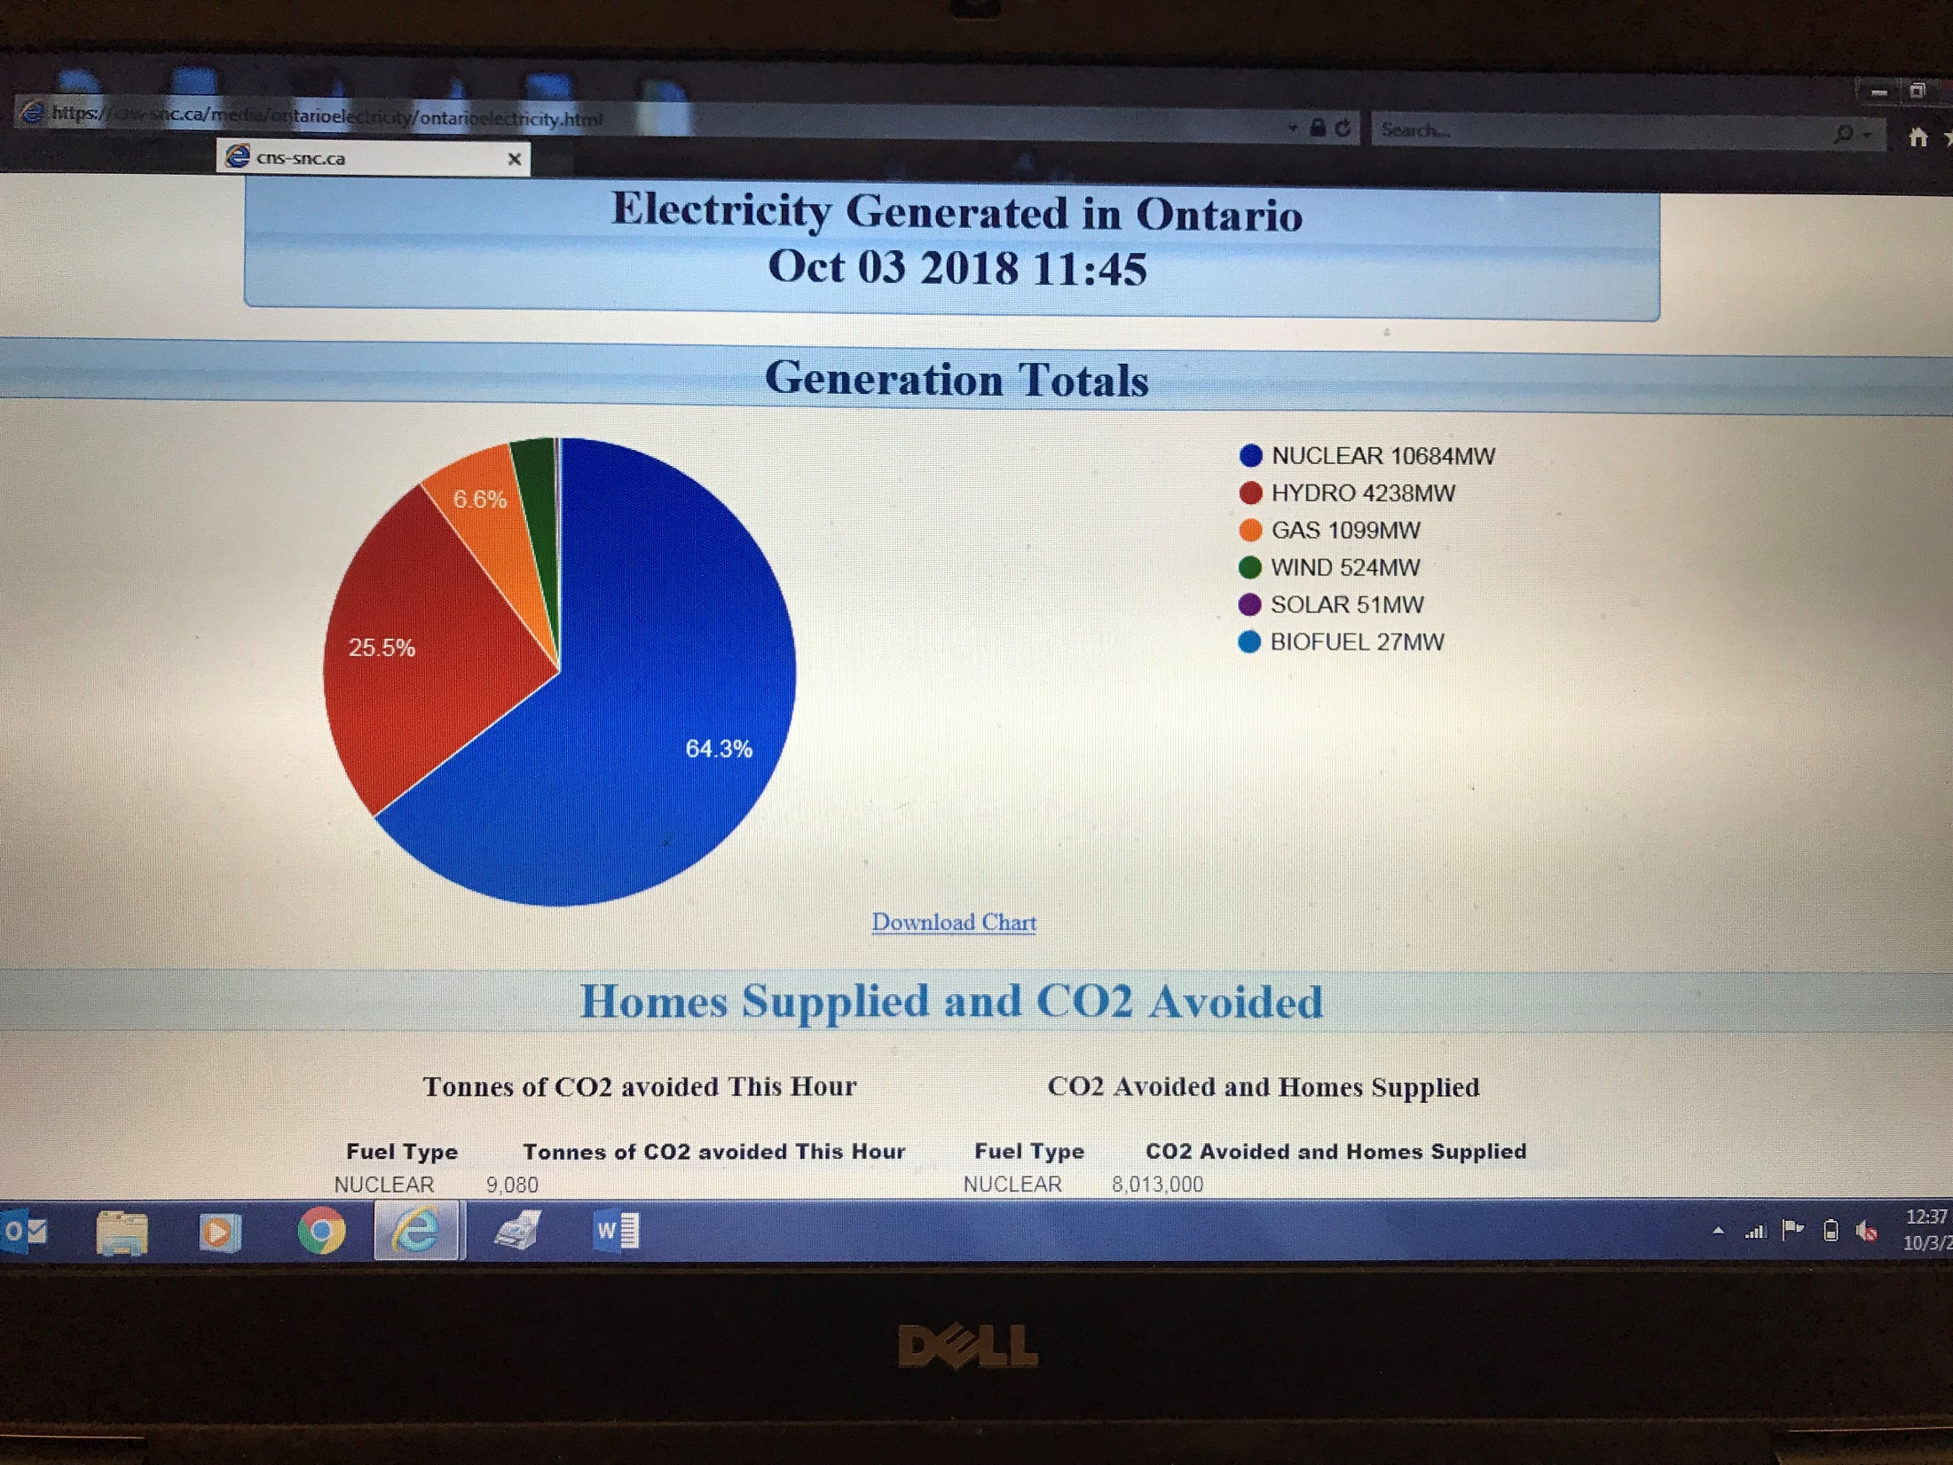

Slide 9
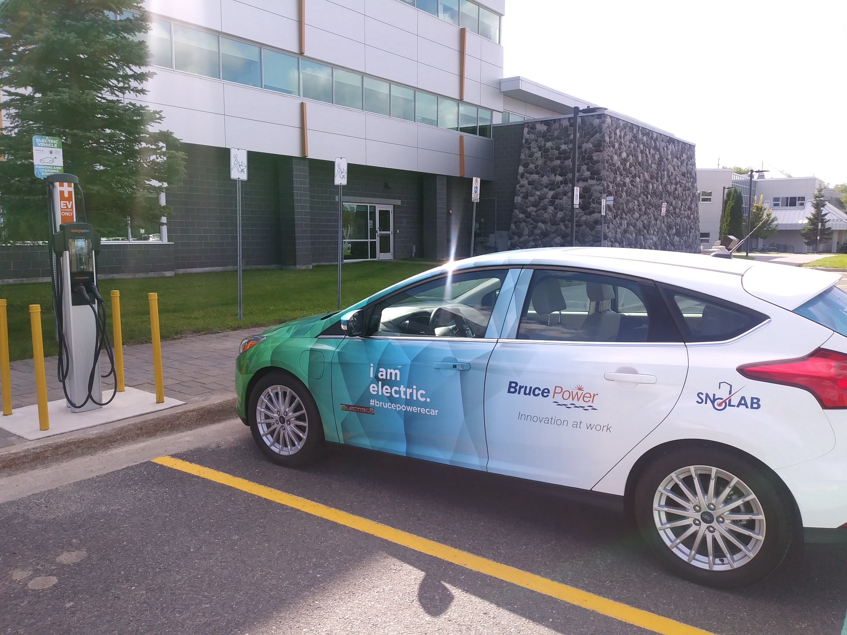

Slide 10
